Slide 1
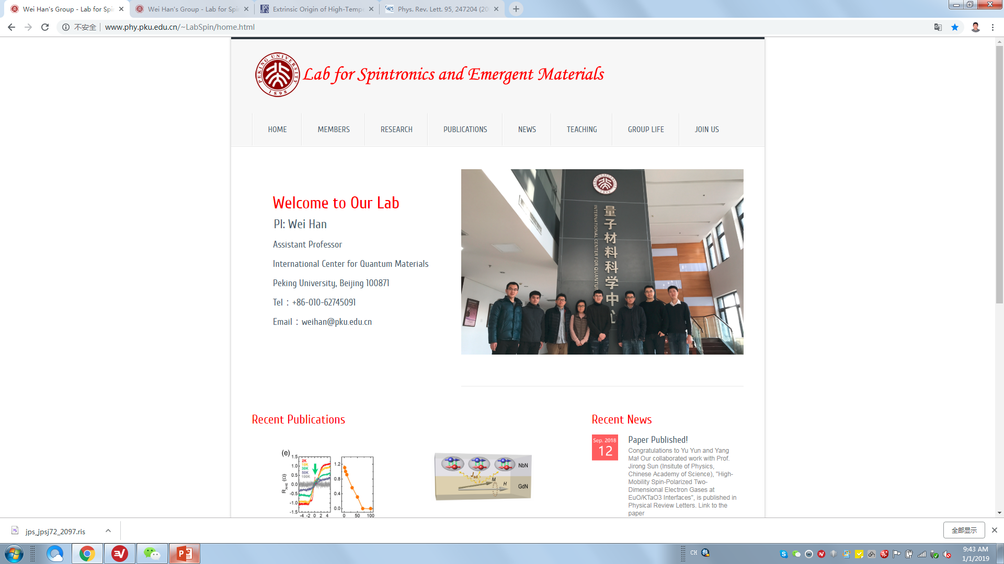
Our group focus on the experimental studies related to spintronics and quantum materials, including:
Spin current as a probe for quantum materials;
Growth of quantum materials thin films;
Quantum materials for spintronics applications.
For more information, see Research

Slide 2
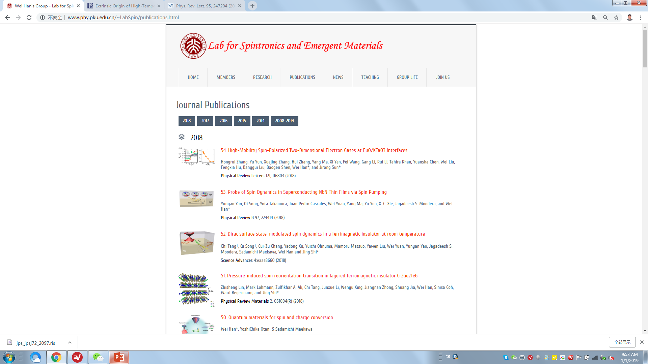
Key
2017-2019
2014-2016
Full list

Slide 3
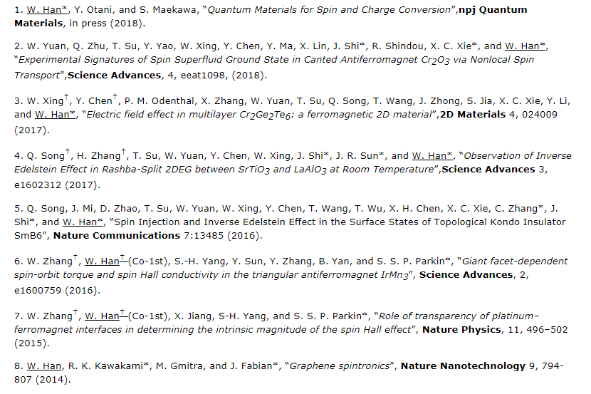
Key

Slide 4
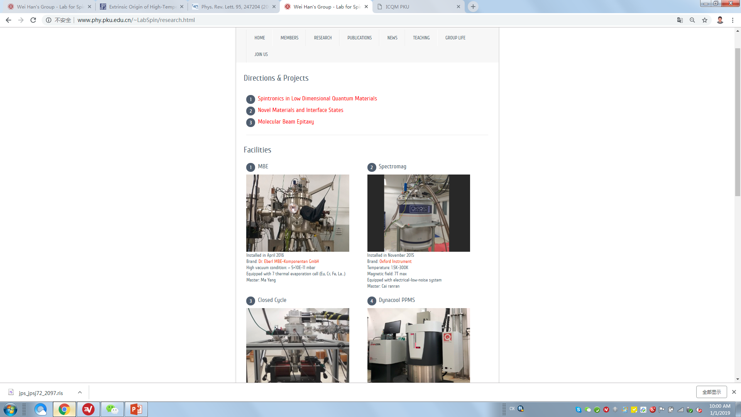
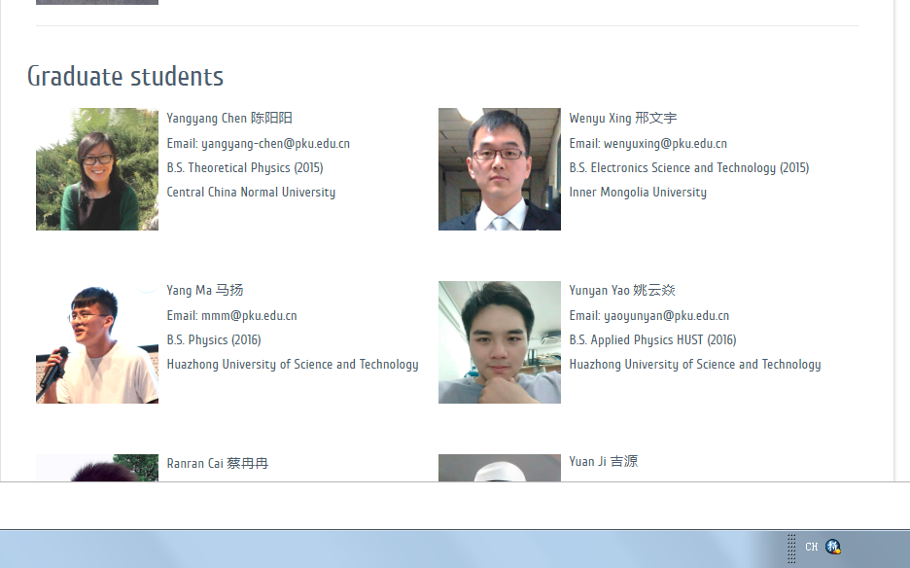
Facilities took too much space.
Refer to the member webpage, pictures smaller.

Slide 5
Our group focus on the experimental studies related to spintronics and quantum materials, including:
Spin current as a probe for quantum materials;
Growth of quantum materials thin films;
Quantum materials for spintronics applications.

Slide 6
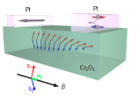
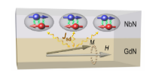
Our group focus on the experimental studies related to spintronics and quantum materials, including:
Spin current as a probe for quantum materials;
Growth of quantum materials thin films;
Quantum materials for spintronics applications.
We use the spin current for the probe of insulating quantum materials, and the quantum interfaces, which are not easily to probe by other techniques. Two examples are spin superfluidity and spin dynamics in superconductor/ferromagnetic heterostructures.
Spin superfluidity. Using the spin current, we observed the experimental signatures for the spin superfluid ground state in canted antiferromagnetic Cr2O3 thin films.
Spin dynamics in superconductor/ferromagnetic heterostructures. Using spin current, we could probe the spin dynamics of the superconducting films from the magnetization dynamics due to the interface exchange interactions.
Refs
Refs

Slide 7

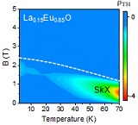
Our group focus on the experimental studies related to spintronics and quantum materials, including:
Spin current as a probe for quantum materials;
Growth of quantum materials thin films;
Quantum materials for spintronics applications.
We use thin film growth techniques (MBE and PLD) to grow quantum materials and interfaces.
Spin polarized interfaces. The interface states are buried between two oxide materials, which can be ferromagnetic using ferromagnetic insulators, such as EuO, and Fe3O4, and Cr2O3.
Novel ferromagnetic oxide materials, such as topological Hall effect in oxide thin films.
Refs
Refs

Slide 8
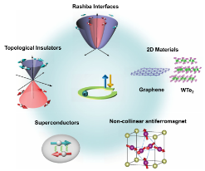
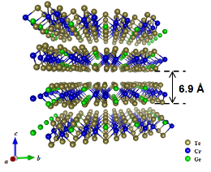
Our group focus on the experimental studies related to spintronics and quantum materials, including:
Spin current as a probe for quantum materials;
Growth of quantum materials thin films;
Quantum materials for spintronics applications.
We take the advantages of the special spin properties of quantum materials, and use them for the spintronics applications.
Quantum materials for spin and charge conversion. The generation and detection of spin current are the central topics in spintronics. These quantum materials, such as topological insulators, 2DEG, and nonconllinear antiferromagnets, provide special platform for the spin and charge conversion.
2D Ferromagnetism. When the ferromagnetism is confined in the 2D limit, new interesting properties could be observed, which might be useful for future spintronics applications.
Refs
Refs

